Slide 1
Pre-requisite
Follow steps in
https://tinyurl.com/odsc-mxnetlab
( This is necessary to get access to Lab )

Slide 2
Execute FER Solution notebook
It takes 50 minutes to train

Slide 3

Deep Learning from Research to Production using Apache MXNet*
Naveen Swamy
Senior Software Engineer
Amazon AI
*
Notes:
Hello, thank you for joining us today. My name is Naveen Swamy, I am a Senior Software Developer at Amazon and I work on Deep Learning frameworks & tools specifically Apache MXNet.

Slide 4
Outline
Review of Deep Learning Concepts
DL in Computer Vision
Apache MXNet
Deep Learning Inference
Notes:
Today I am going to briefly introduce you to Deep Learning,
Deep Learning for Computer Vision
I will then introduce you to Apache MXNet DL framework
Lastly Deep Learning Inference.
So Lets get started

Slide 5

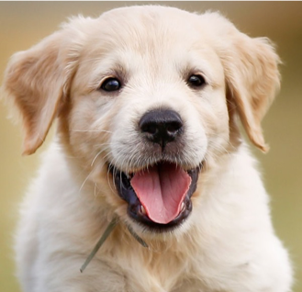
Deep Learning
CAR
DOG
Output
(object identity)
PERSON
3rd hidden layer
(object parts)
Originally inspired by human biological neural systems.
A system that learns important features from experience.
Layers of neurons learning concepts.
Deep learning != deep understanding
2nd hidden layer
(corners & contours)
1st hidden layer
(edges)
Input layer
(Raw pixels)
Source: Ian Goodfellow etal., Deep Learning Book
Notes:
Let me start out by asking how many of you know the difference between ML & Deep Learning?
Like you all know Machine Learning is about using algorithms to learn patterns from raw data and make decisions.
In traditional ML, before you could use a Algorithm, you had to go through a step called Feature extraction where you carefully handcrafted the salient features of your data, this had some drawbacks from requiring domain expert, being error-prone and it did not work for new problems.
Deep Learning or Neural Networks solves these problems differently. The term Deep Learning or Neural Networks is used Interchangeably
The area of neural network design was originally inspired by how learning happens in our brain. Today it has diverged to become more of a engineering and algorithm challenge to solve various ML tasks.
In this system, the most important features are learnt by itself from experience. It understands in terms of hierarchy of concepts building one concept at a time.
Lets take an example of Image classification task where the objective is given an image, to find the most prominent object in the image from a predefined set of classes.
Consider this network of many layers, which can classify images into 3 different categories.
First, you have an input layer to which you feed the input raw pixels.
and then there is the first hidden layer which tries to learn edges by looking at the brightness of the neighboring pixels.
The layers between input and output are called hidden layers because the values are not given in the data and the network should learn values that are required to explain the relationship.
the 2nd hidden layer is extracting corners and contours.
3rd hidden layer learning object parts in the image
and finally the output layer tells you what object it is from the predefined set of classes. Here we have 3 classes and we get confidence score for each of them. For the output dog we would get a higher probability score.
It is important to note that the word deep in Deep Learning is not to mean that the system is gaining deeper understanding, rather to say that the number of layers is very large. The number of layers in the network is also called depth of the Network

Slide 6

Deep Learning Training
forward
dog
?
error
Pass data through the network – forward pass
Define an objective – Loss function
Send the error back – backward pass
Model: Output of Training a neural network
dog
X₁
forward pass
h₁
w1 = 0.5
w5 = 0.4
y = 1.0
y` = 0.9
loss = y – y`
l = 0.1
0.1
y
w3 = 0.5
0.1
backward
w4 = 0.5
labels
w6 = 0.5
data
X₂
w2 = 0.5
h₂
backward pass
Notes:
Hopefully you are convinced that Deep Learning is a here to stay and useful . So, lets see how it works.
Deep Learning has 2 phases:
1st is Training where you build a neural network and pass through it lots and lots of data.
Lets consider this dummy network, we have an input layer with 2 inputs x1 and x2, a hidden layer and a output layer with single output. The connection between layers have weights, and they start out with randomly initialized.
So How does learning happen ?
We feed the networks with samples from the dataset and see what output it produces – this is also called forward propagation or forward pass.
Verify the output against the ground truth and calculate the loss, if the output does not meet the objective we propagate back the loss and update the weights finding gradients of each weight. This is called Backward propagation or backward pass. Mathematically this is chain rule applied on the graph.
We do this many many times until the network learns the weights to meet the objective
At which point we get a Pre-trained model.
The Backwards Pass is where learning happens. Through repeated iterations, we use gradients to reduce the loss and increase the accuracy of the model.

Slide 7
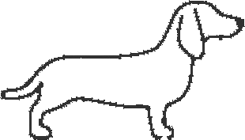
Deep Learning Inference
Real time Inference: Tasks that require immediate result.
Batch Inference: Tasks where you need to run on a large data sets.
Pre-computations are necessary - Recommender Systems.
Backfilling with state-of-the art models.
Testing new models on historic data.
forward
dog
model
Notes:
Inference is applying new data on a pre-trained model to get predictions, its basically only running forward pass of the network.
Now Inference can be done in two modes
First, You can run Online or Real-time mode where you need result immediately from your model. For example a model that does Fraud-detection.
And you can run in Offline or Batch mode when you have a large dataset. This is useful when
Pre-computations are necessary, for services that have low-latency requirements such as Recommender systems
Or if you want to backfill Historic data with the state of the art model.
Another use-case is when you want to Test new models on historic data to verify if they yield better results before they are deployed in production

Slide 8
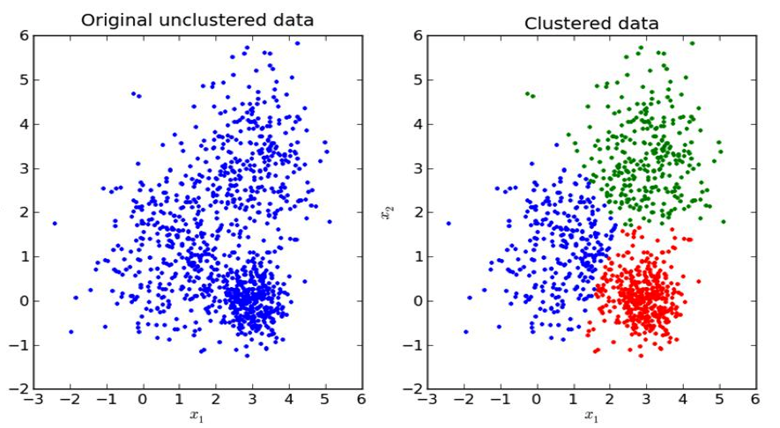
Types of Learning
Supervised Learning – Uses labeled training data to associate input data to output.
Classification: Output is discrete categories
Regression: Output is a continuous value
Example: Image classification, Speech Recognition, Machine translation
Unsupervised Learning - Learns patterns from Unlabeled data.
Example: Clustering, Association discovery.
Active Learning – Semi-supervised, human in the middle..
Reinforcement Learning – learn from environment, using rewards and feedback.
Notes:
Lets look at some popular types of Learning in Neural Networks.
Supervised learning, you tell the computer program what semantic content is contained in your data, often thousands of input at a time. For example here is an image and it contains a `dog`
Applications that are leveraging include Image classification, Speech Recognition, Machine translation.
Unsupervised Learning, We try to make sense of the unlabeled data and get information from it.
Example: Clustering, Association discovery. You could use Clustering to do topic modeling on a corpus of text data.
Active Learning is a semi-supervised learning technique that uses a human in the middle of the pipeline. There is lots of unlabeled data, this system tries to learn concepts from this data and when uncertain it queries users for labels.
Reinforcement learning where the system or an agent is learning based on the experiences in its current environment through the use of rewards and feedback.

Slide 9
Steps in Training
training loop
pre-process
data
define
neural network
define
loss function
feed a batch of data
measure training accuracy and loss
validate model
update weights
W = W + 𝞭W
find gradients
loss & optimization
backprop
Notes:
Lets look at how to train a neural network, invariably there is some form of data pre-processing required. one of them is normalizing your data so no one input has undue influence on the weights learnt, we do this by centering data and subtracting the mean of the input from every input.
Next we will define the neural network, earlier we saw MLP with hidden layers. Number of layers and number of units in each layer are hyper-parameters.
We will define a loss function that measures the difference between the scores produced by the model and ground truth value.
We split the training data into batches, Next feed a batch of data from the input data set, we evaluate the training accuracy – calculate as a percentage how close the predictions are to ground truth.
We also separately validate our learned parameters against a validation dataset. The validation dataset is different from Test dataset, we don’t want to touch the test dataset during training and is considered precious since we don’t want to the parameters to be influenced by the test dataset, we want the parameters that are generalized and can work on a wide variety of input.
We create a Validation dataset by using 10% or 20% of the training data.
then we calculate the loss, apply optimizer to find gradients and finally update the weights. We do this for all the batches of input. We’ll see the details in a minute.
We continue to run this loop for many iterations until our accuracy objective is met, an iteration is also called a epoch.

Slide 10

Optimization
find parameters that minimize the loss function
Gradient Descent: Iteratively update parameters to get the most optimal value for the objective function
Notes:
Optimization is the process of finding parameters minimizing the loss function.
A naïve way to minimize loss function would be by
Random Search: We could try out many different parameters by randomly picking weights and keeping track which set of weights produces the least loss. This requires a lot of tries to even get a decent accuracy.
The popular analogy used to describe is the Blindfolded hiker who is on the hill and trying to get to the bottom of the hill. Here the hiker would take a random step and see if that is taking him down.
Another approach is to extend one foot randomly and take the step only if its leading downhill.
We start with random Weights and generate deltas and compute the loss and update the weights only if the new weights produce lower loss. This is slightly better.
Improving a set of weights is easy to do iteratively rather than find the best weights.
There is a better and mathematically guaranteed way to find the steepest descend along which we can change the weights. This is the gradient of the loss function. gradient is the derivatives of vector of numbers.
In the hiker analogy we feel the slope of the hill before taking the step.
---
finding best set of weights is very difficult or even impossible
less difficult to improve a particular set of weights.
use gradient of the loss function to update our weights which will minimize the loss.

Slide 11
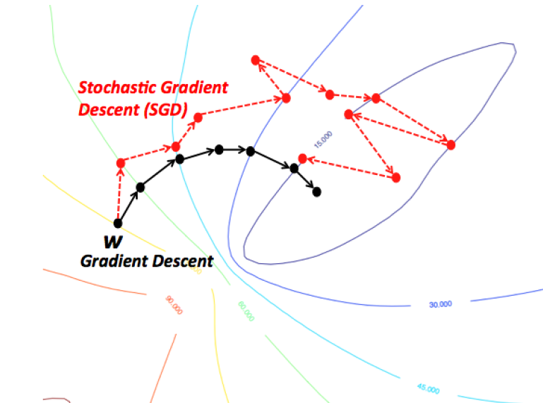
Stochastic Gradient descent
A single iteration for the parameter update runs through a BATCH of the training data
while True:
data_batch = sample_training_data(data, batch_size)
weights_grad = evaluate_gradient(loss_fun, data_batch, weights)
weights += - step_size * weights_grad
Notes:
Training data often contains millions of data, its expensive and wasteful to compute loss through all the data just to make a single parameter update, instead in Stochastic gradient descent we take batches of data and compute the gradient. This is more effective and efficient since we can vectorize these operations especially with GPUs to yield us faster learning.

Slide 12
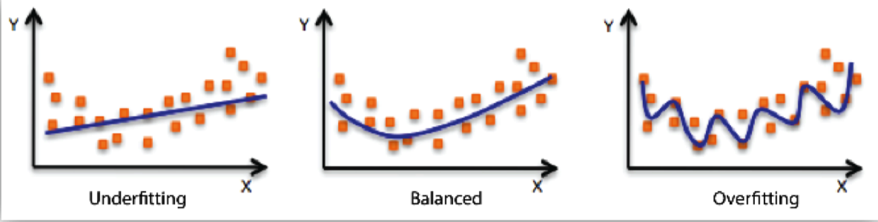
Overfitting/Underfitting
Underfitting: model performs bad on training data
Adding new features, increase feature cartesian product – nth degree polynomial , reduce regularization.
Overfitting: the model performs well on the training data but does not perform well on the validation data.
Use Regularization
Notes:
W is not unique that can correctly classify every example.
The model underfits when it cannot capture the underlying relationship in the data, this is when the model is too simple model, generally has low varience and high bias
We fix this by Adding new features, increase feature cartesian product giving a nth degree polynomial and also by reducing regularization
Overfitting: Performs better on Training data but not evaluation data, the model has not generalized and is memorizing the data it has seen and is unable to generalize to unseen examples. This happens when the model is too large and starts capturing the noise in the data.
Number of parameters is large.
Model parameters can take a wide range of values
Training Dataset is small.
We solve this by adding Regularization.

Slide 13

Dropout
keeping a neuron active with some probability p
forces learning by all neurons.
dropout is only applied during training and not at test.
Srivastava, Nitish, et al. ”Dropout: a simple way to prevent neural networks from
overfitting”, JMLR 2014
Notes:
Dropout is a type of regularization implemented by keeping a neuron active with some probability p,
We only update the parameters of the sampled network based on the input data.

Slide 14

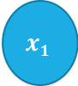



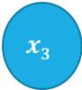

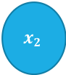

Perceptron
$$x1$$
z $=Φ\left(b+Σ_{i}\left(w_{i}.x_{i}\right)\right)$
$$y =\left\{\begin{aligned}1, if z≥threshold \\ −1 \end{aligned}\right.$$
Weighted Linear Combination of Input and weights
Linear/Non-Linear decision
Linear Offset = Bias
Learn W and b
$$x2$$
$$w1$$
$$w2$$
$$x3$$
y
$$w3$$
$$x4$$
w_{n}
b
$$x5$$
1
Notes:
Perceptron dates back to 1960s and is considered the first generation Neural Networks modeled after our brain cells.
The goal of Perceptron is to find a linear function Z such that y is 1 whenever Z is over a certain threshold. Z is a Weighted sum of the input feature vectors and weights. The weighted sum of input and weights is dot product between the 2 vectors.
We could apply a linear function such as a step function on the weighted sum or a non-linear function on the weighted sum to get the output, because the output does not necessarily vary linearly with respect to input.
As a reminder linear functions have their output vary linearly i.e., proportionately with regards to the input. A Bias term helps is offsetting the output vector
The learning part here is how to weight each input feature to get the scalar output.

Slide 15
Perceptron
Ham
Spam
Notes:
Classify Emails into Ham and Spam
Find whether a user will click an ad or not on a website
What we are trying to find here is a linear separating Hyperplane separating one vs the other.

Slide 16
Multi Layer Perceptron
a.k.a Fully Connected Networks/ Feed Forward Networks or Dense Layers
Notes:
Perceptron can only solve linearly separable problems.
But many real world examples do not have linear co-relation between input and output, so we need something better than a Perceptron that can model these non-linearities.
We can model a more general class of functions by stacking layers.
Each neuron in a layer is connected to all the neurons in the previous layers. Hence its also called Fully connected Network
Each layer has its own weights.
We also apply a non-linear function element-wise on the output of the hidden layer.
MLPs are also called Fully connected Neural Networks or Feed Forward Neural Networks or Dense Layers

Slide 17
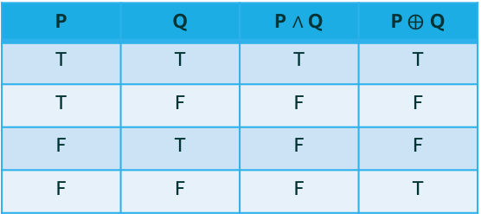


Activation/ Non Linearity
many real world problems problems cannot be expressed with a linear function.
Without non-linearity, model is just computing a linear function.
Source: Andrew Ng’s DeepLearning course
P | Q | P $∧$Q | P$⨁$ Q
T | T | T | T
T | F | F | F
F | T | F | F
F | F | F | T
0
1
0
1
0
0
1
0
P$∧$Q
P$⨁$Q
non-linear
linear function
Credits: Cyrus Vahid
Notes:
Without Non linearity, the network is just computing a linear function..
Many real world problems do not have a linear co-relation. By adding Non-linearity in the hidden layers, we can find useful patterns in data.
In the simple network above as shown by Andrew Ng. Let the hidden layer’s output is z and if we were to just replace that the activation with a Linear or Identify Function
Replacing z1 for a1 in the equation a2 it reduces (w1w2) x + 2b1+b
If we consider the first term as w prime and b prime..it reduces just to a linear function.
Now this will be true regardless of how many ever layers you add which would be useless
Lets look at the example of solving an XOR function where the output is true when both inputs are true or false and otherwise this cannot be expressed using a linear function

Slide 18
Convolutional Neural Networks
Convnets exploits the spatial co-relation in images.
vastly reduces the number of learnable parameters.
Neurons connected to a small region of the previous layer.
Convnet architecture uses 3 types of layers CONV, POOL, FC
Each layer transforms 3D input volume to 3D output volume of neuron activations.
Convnet Arrangement
Source: Andrej Karpathy’s cs231n
Notes:
MLPs are not sufficient to solve complex real world problems such as Image Classification. The problems with MLPs are
They are sensitive to position within Image, they don’t exploit spatial co-relation in images.
In a fully connected neural network each neuron is connected to all neurons in the previous layer thus the number of parameters will be really large. In CNNs neurons connect only to a small region of the previous layer.

Slide 19

Convolutional layer
Slide a kernel across the input image to get an output volume of activations.
A kernel or filter is spatially small tensor that extends to full input depth.
Each neuron in output is connected to a small patch in input.
multiple filters each learning different feature at a given layer.
Notes:
Now lets look at each of the CNN layers, firstly Convolutional layer.
In convolutional layer, a tensor that is spatially small in terms of height and width but extends to full input depth is slide across the input image to get a volume of activations. The filter has a depth equal to the depth of the input.
The spatial extent of this connectivity is called receptive field of the neuron or the filter size F
The sliding length is called Strides.
Often the input image is padded with zeros across height and width of the image to capture information on the borders. This is called Zero padding.
During the forward pass, the sliding computes dot products between the entries of the filter and the input. Each neuron in the output activation is connected by FxFxD weight tensor to the input patch. The filter weights are shared across the spatial dimension
The filters values are learnt during the training process.
Filter weights are shared across the spatial dimension in a single depth slice.

Slide 20
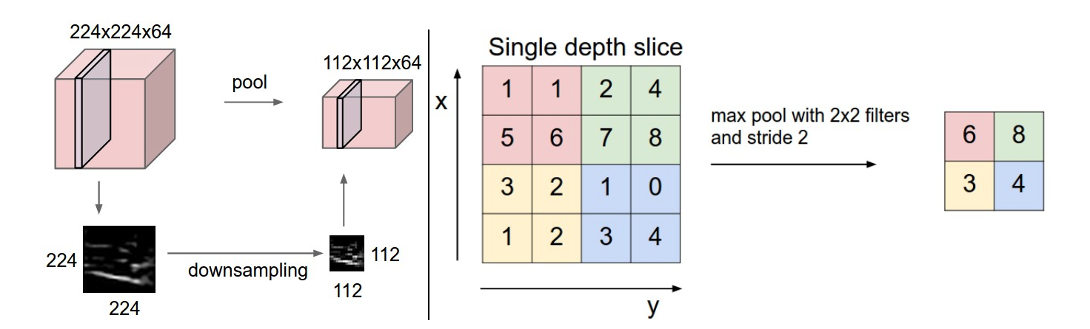
Pooling
Down samples input to pick the most important features
Reduces spatial size, parameters and compute.
MAX, AVG, L2-NORM Pooling
Source: Andrej Karpathy’s cs231n
Notes:
Output
W₂ = (W – F )/S +1, H₂ = (H – F )/S +1, D₂ = D1

Slide 21
Outline
Review of Deep Learning
DL in Computer Vision
Apache MXNet Framework
Deep Learning Inference
Notes:
Thus far we have covered Deep Learning concepts and why it is big deal, this is only a tip of the iceberg and there is lots more.

Slide 22
Apache MXNet - Background
Apache (incubating) open source project
Framework for building and training DNNs
Created by academia (CMU and UW)
Adopted by AWS as DNN framework of choice, Nov 2016
http://mxnet.apache.org
Notes:
Just a bit of background on MXNet:
It is an Apache open source project. People sometimes think it is an “Amazon Project” but it is not. It is truly open source, decisions are made by the community. However, it is true that AWS is contributing a lot to the project.
It is a framework for building, training and using DNNs for inference. Similar to TF, PyTorch, etc.
It originated in the adademia, CMU and UW
Aws adopted MXNet late 2016 as “DL FW of choice), there’s a nice blog post by AWS CTO (Vogels) explaining more in details. A lot of it is about scalability and MXNet being good for production use.

Slide 23
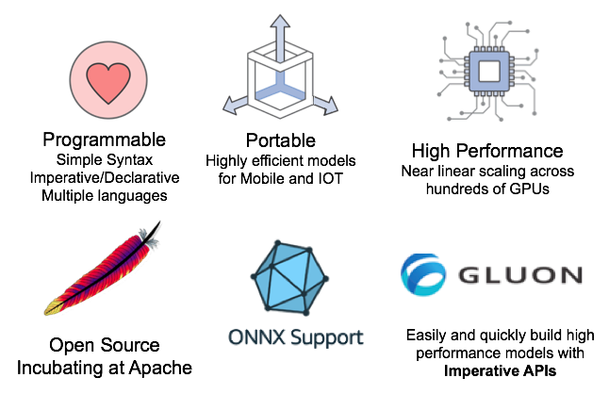
Why MXNet
Notes:
Now lets see what’s different about MXNet. Started Academia and supported by Enterprises
First, It support of multiple programming languages through Simple Syntax. It supports both Imperative and Declarative style of Programming.
Next. you can create highly optimized models for use in Mobile and IOT
It is also Highly performant, i.e., It achieves near linear scaling in training across hundreds of GPUs.
It is truly open source, currently Incubating at Apache. With a show of hands, how many of you know what it means to Incubate at Apache.
Great, for those who do not know Every project before getting accepted by the Apache Software Foundation has to go through the incubation phase where the board assigns long time Apache members as Mentors who guides and monitors the project to see that the governance is democratic and no one organization is unduly influencing.
ONNX Support – This is a new open source initiative driven by Amazon, Facebook and Microsoft to define a Interoperable format for models, this means you can train on any other DL framework and run on MXNet.
Finally, MXNet implements Gluon Imperative APIs, Gluon is an open-source effort by Amazon and Microsoft to standardize APIs for Deep Learning that are simple, ease of understand and high performant. So now you can prototype very quickly, MXNet can also generate highly-efficient Symbolic graph out of this, so you won’t loose performance.

Slide 24



























Apache MXNet Customer Momentum
Notes:
Use customer references verbally
Customers that chose MXNet due to multi-GPU training support and high scalability.
Curalate, TuSimple, Borealis AI, NTT Docomo
Designed to be easily wrapped by other languages
Wolfram integrated MXNet as the backend of Mathematica for building NN
Curalate is using Scala inference API
We have an enterprise customers who is running 100+ MXNet – Gluon models in production for product recommendation across 26M+ user base

Slide 25
MXNet Gluon – Imperative & Fast
Simple, Easy-to-Understand Code
Neural networks can be defined using simple, clear, concise code
Plug-and-play neural network building blocks – including predefined layers, optimizers, and initializers
Flexible, Imperative Structure
Eliminates rigidity of neural network model definition and brings together the model with the training algorithm
Intuitive, easy-to-debug, familiar code
Dynamic Graphs
Neural networks can change in shape or size during the training process to address advanced use cases where the size of data fed is variable
Important area of innovation in Natural Language Processing (NLP)
High Performance
There is no sacrifice with respect to training speed
When it is time to move from prototyping to production, easily cache neural networks for high performance and a reduced memory footprint
Credits: Cyrus Vahid

Slide 26
GluonCV: a Deep Learning Toolkit for Computer Vision https://gluon-cv.mxnet.io
50+ Pre-trained models, with training scripts, datasets, tutorials

Slide 27
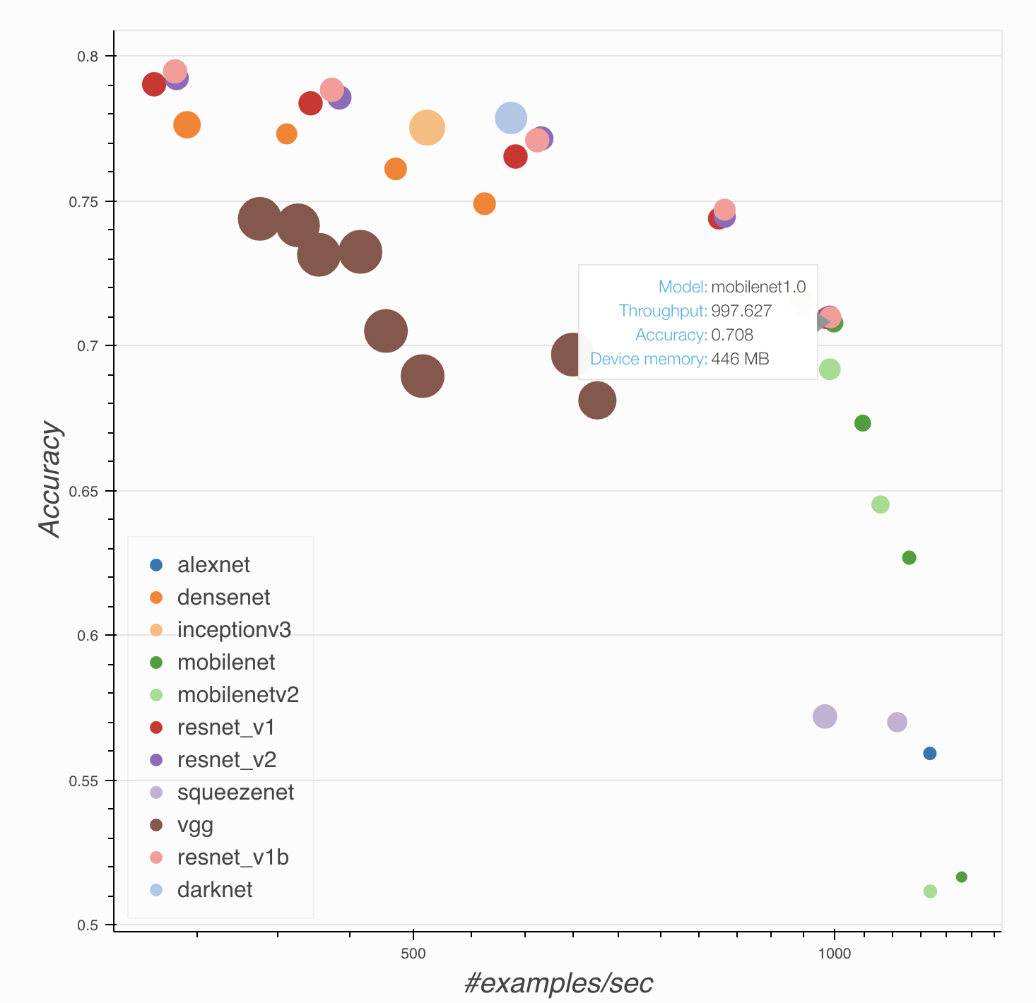
GluonCV: pre-trained models, help to choose

Slide 28
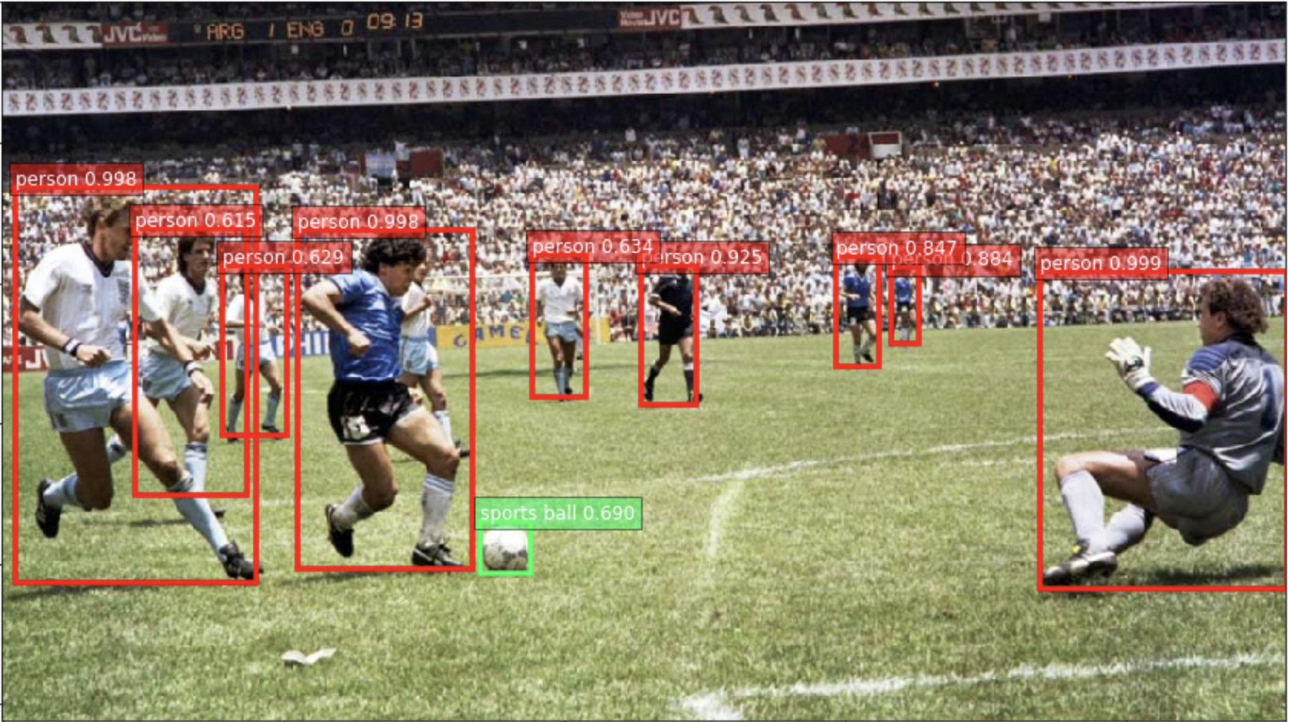
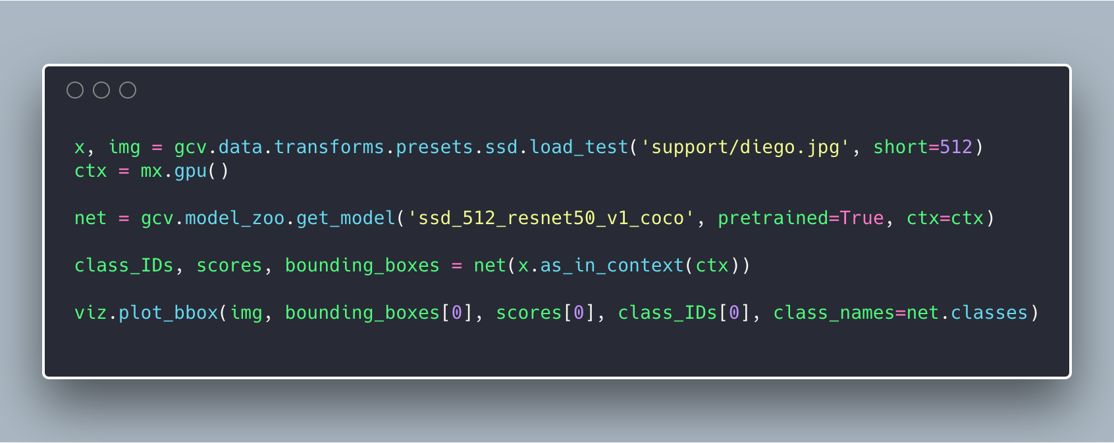
GluonCV: example code

Slide 29
Outline
Review of Deep Learning
DL in Computer Vision
Apache MXNet framework
Deep Learning Inference
Notes:
Thus far we have covered Deep Learning concepts and why it is big deal, this is only a tip of the iceberg and there is lots more.

Slide 30
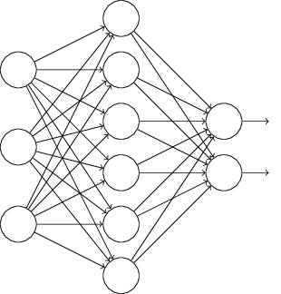
So what does a deployed model looks like?
Model
Mobile
Internet
Model Server
Desktop
IoT
Credits: Hagay Lupesko
Notes:
OK, so hopefully by now you are convinced that Deep Learning is awesome, and the next thing you want to do is use it in your production system.
So, how do you actually use a deep learning model in your production environment?
Let’s start with the outcome we’re trying to achieve. In fact, it is pretty straight-forward, and is not very different than deploying any other service.
We have a trained model, that we want to use for inference,
We have a bunch of clients: mobile, desktop, iot, cloud – or any combination of those
We want to have a server of sorts, hosting a trained model, exposing an inference API, which when called runs a feed forward through the network doing the deep learning “magic” Naveen explained earlier.
That’s a very simple schema of model serving setup.

Slide 31

The Undifferentiated Heavy Lifting of Model Serving
Performance
Networking
Monitoring
Model Decoupling
Cross Framework
Cross Platform
Availability
Model Server for MXNet
Credits: Hagay Lupesko
Notes:
As we saw in the previous slide, in many ways, serving deep learning models is similar to other, more traditional, serving frameworks out there, such as Apache Tomcat. And indeed in many ways, Model Serving is undifferentiated heavy lifting. That is a term we use and focus on in AWS a lot. What it means is all of the aspects that are necessary to get the job done, but that are not differentiating your business, things like setting up servers, networks, etc. is all UHL.
Let’s quickly go over the main concerns Model Serving system needs to address:
- Performance – this concern is about providing a scalable architecture that is able to meet target TPS, making an efficient use of the available compute resources, strike the right balance between throughput and latency. It is especially important for Deep Learning, since the computational load of running a single inference is typically significant. As a reference, a model such as ResNet-152 requires billions of FLOPs for a single forward pass.
Availability – to make your application working properly all the time, you want to minimize down time, and avoid offline status when load is high, or when you are busy deploying a new model.
Networking – making your model consumable means you need to expose a network endpoint that clients can call to get predictions. This endpoint needs to support standard interfaces such as HTTP, error codes, security and more.
Monitoring – having any service in production means you need the ability to look into your operational metrics in near-real time; things like resource utilization on host, inference latencies, requests and errors.
Model Decoupling– when you are serving models you want to offer a way that enables to use trained models without knowing anything about their inner working details. The model may be identifying cats in images, or doing sentiment analysis. No change should be done to the server beyond deploying a different model.
Cross Framework – there are many different Neural Network frameworks: MXNet, TensorFlow, PyTorch, Caffe, and more. “Same Same, But Different” - all similar, but different in style and implementation details. We want a model server that just works, regardless of the framework used to build and train the model.
Cross Platform – similar to how there are many frameworks, there are also many platforms you can run your server on. From the OS (Linux, Windows) to the actual compute processor which can be a CPU, a GPU or a TPU.
And beyond all of that, one uber-concern that is an important meta concern is Ease of Use – all of the concerns just mentioned needs to be addressed in a way that is easy to use, quick to learn, and just work!

Slide 32
Model Archive
Trained Network
Model Signature
Model Archive
Model Export CLI
Custom Code
Auxiliary Assets
Back
Credits: Hagay Lupesko
Notes:
To decouple the actual model from the serving framework, we designed the “Model Archive”.
Model Archive is a file that encapsulates all of the model-specific logic. It is the one-and-only resource MMS needs in order to set up serving for the model. In many ways, it is similar to Java’s JAR file – and indeed we have took a similar implementation approach.
Let’s take a look at what is needed to generate a model archive: a trained neural network, a signature file defining input and output types and shapes, which tells MMS what endpoints to setup, and how to transform the inputs and outputs. Then there’s the option to include custom code, which allows users to add feature extraction logic, or any other init/pre/post processing logic they may want to build into the model. Additionally, users can package whatever other additional files their model will need at runtime. Class labels is an example use case for aux files.
Users use the MMS export CLI to package up all of these assets into a Model Archive package, which is then used by MMS to initialize and serve requests as we’ve seen earlier.
This decoupling enables a clean separation of responsibilities between model creation and model serving. 1. The ML Engineer or Data Scientist build and trains the model, writes feature extraction code, and then packages it all up into the archive.
2. The Software Engineer or Dev Ops Engineer setup up MMS on a prod cluster, and configures MMS to point to the archive, either on the local FS or on a remote URL.
Let’s quickly jump to the console to see how this looks (DEMO)
Show a pre-prepared folder with model, signature, code and aux files
Open the signature and show
Open the code and show
Show how the export utility is used

Slide 33
Containerization
Lightweight virtualization, isolation, runs anywhere
Container Cluster
MMS Container
MMS Container
MMS Container
MXNet Model Server
MXNet
Netty
Pull or Build
Push
Launch
MMS Dockerfile
Back
Credits: Hagay Lupesko
Notes:
As I demoed, you can easily run MMS on your Mac. While this will work well for prototyping or testing, it is not a scalable setup for high-load production traffic. For production deployments we recommend using containers: they are lightweight, provides isolation and have wide platform support. The MMS repo includes Docker images that are pre-configured with required software components and configuration for optimal execution. Users can use this image with their container orchestration tool of choice, and there’s plenty of good options out there such as ECS, Docker and Kubernetes.
Users can pull a pre-built, optimized, docker image, or build one themselves, push it to a registry, and then orchestrate it with a platform such as ECS. ECS manages the cluster, including scaling, load balancing, networking, instrumenting and more. The MMS image itself includes an NGINX network reverse proxy, integrated with MMS.
To learn more about MMS container setup, visit the GitHub repo, where we have details and instructions. We just published a blog post showing how you can setup a serverless MMS container cluster with ECS Fargate - it is pretty cool!

Slide 34
MXNet Model Server
Machine learning model server
Serves MXNet and ONNX models
Automated HTTP endpoints setup
Auto-scales to all available CPUs and GPUs
Pre-built and configured containers
CLI to package model artifacts for serving
Open source project under AWS Labs
http://modelserver.io
Credits: Hagay Lupesko
Notes:
Just a bit of background on MXNet:
It is an Apache open source project. People sometimes think it is an “Amazon Project” but it is not. It is truly open source, decisions are made by the community. However, it is true that AWS is contributing a lot to the project.
It is a framework for building, training and using DNNs for inference. Similar to TF, PyTorch, etc.
It originated in the adademia, CMU and UW
Aws adopted MXNet late 2016 as “DL FW of choice), there’s a nice blog post by AWS CTO (Vogels) explaining more in details. A lot of it is about scalability and MXNet being good for production use.

Slide 35
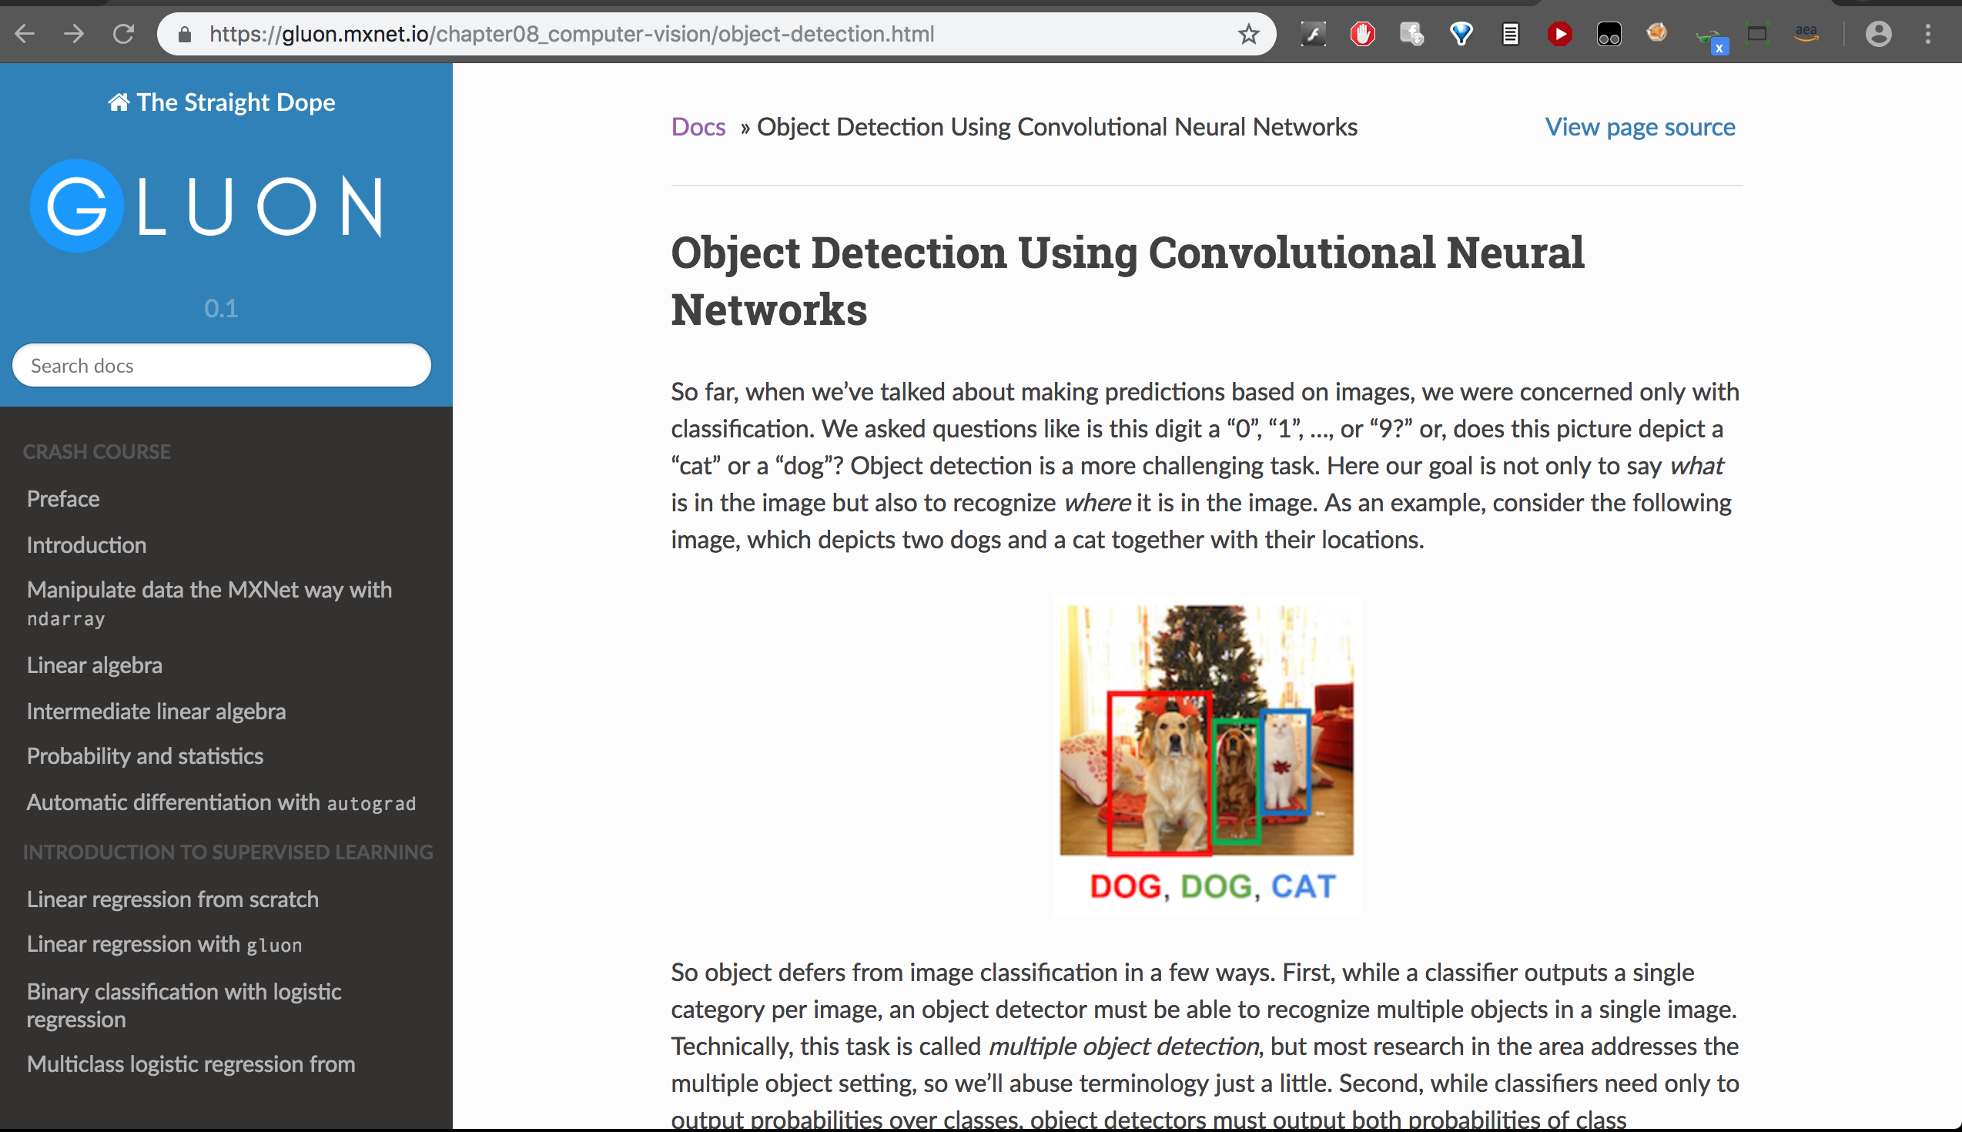


Slide 36
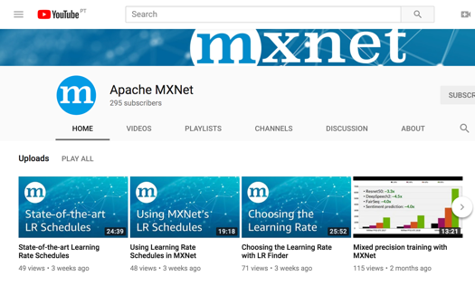


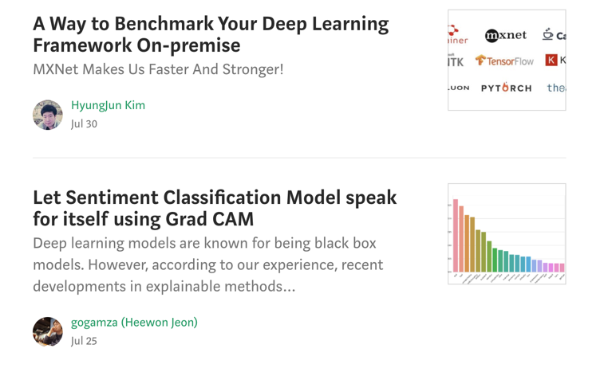
Apache MXNet Social
YouTube: /apachemxnet
Twitter: @apachemxnet
Medium: /apache-mxnet
Reddit: r/mxnet
Notes:
https://www.reddit.com/r/mxnet/

Slide 37
Resources/References
Apache MXNet – Flexible and efficient deep learning.
https://github.com/apache/incubator-mxnet
https://github.com/TalkAI/apache-mxnet-odsc-2018
Apache MXNet Gluon Tutorials
The Deep Learning Book
MXNet – Using pre-trained models
Amazon Elastic MapReduce
https://medium.com/apache-mxnet
https://twitter.com/apachemxnet
Notes:
GitHub Repo of MXNet
Blog on this topic.
Code Sample
Gluon has a great set of tutorials to learn deep learning starting from the basics all the way to building a Object Detector on images containing multiple objects.
The Deep Learning Book by Yoshua Bengio and others is great if you want go really get a deep understanding of DL.

Slide 38
Thank You wamy@amazon.com
Notes:
If you have questions or want to chat more – I’ll be around, so feel free to drop by!

